Slide 1

DolphinGroup
NICE TO MEET YOU, TOO
CASE STUDY chapter 2

Slide 2
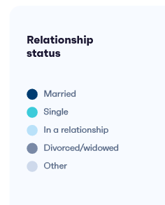


DolphinGroup
AGENDA
INTRODUCTION
Executive Summary
Background Information
Goals
ANALYZATION
Key issues and Problems
Case Evaluation
Proposed Solutions
SUMMATION
Conclusions
Recommendations
Credits
Q&A
Ending

Slide 3
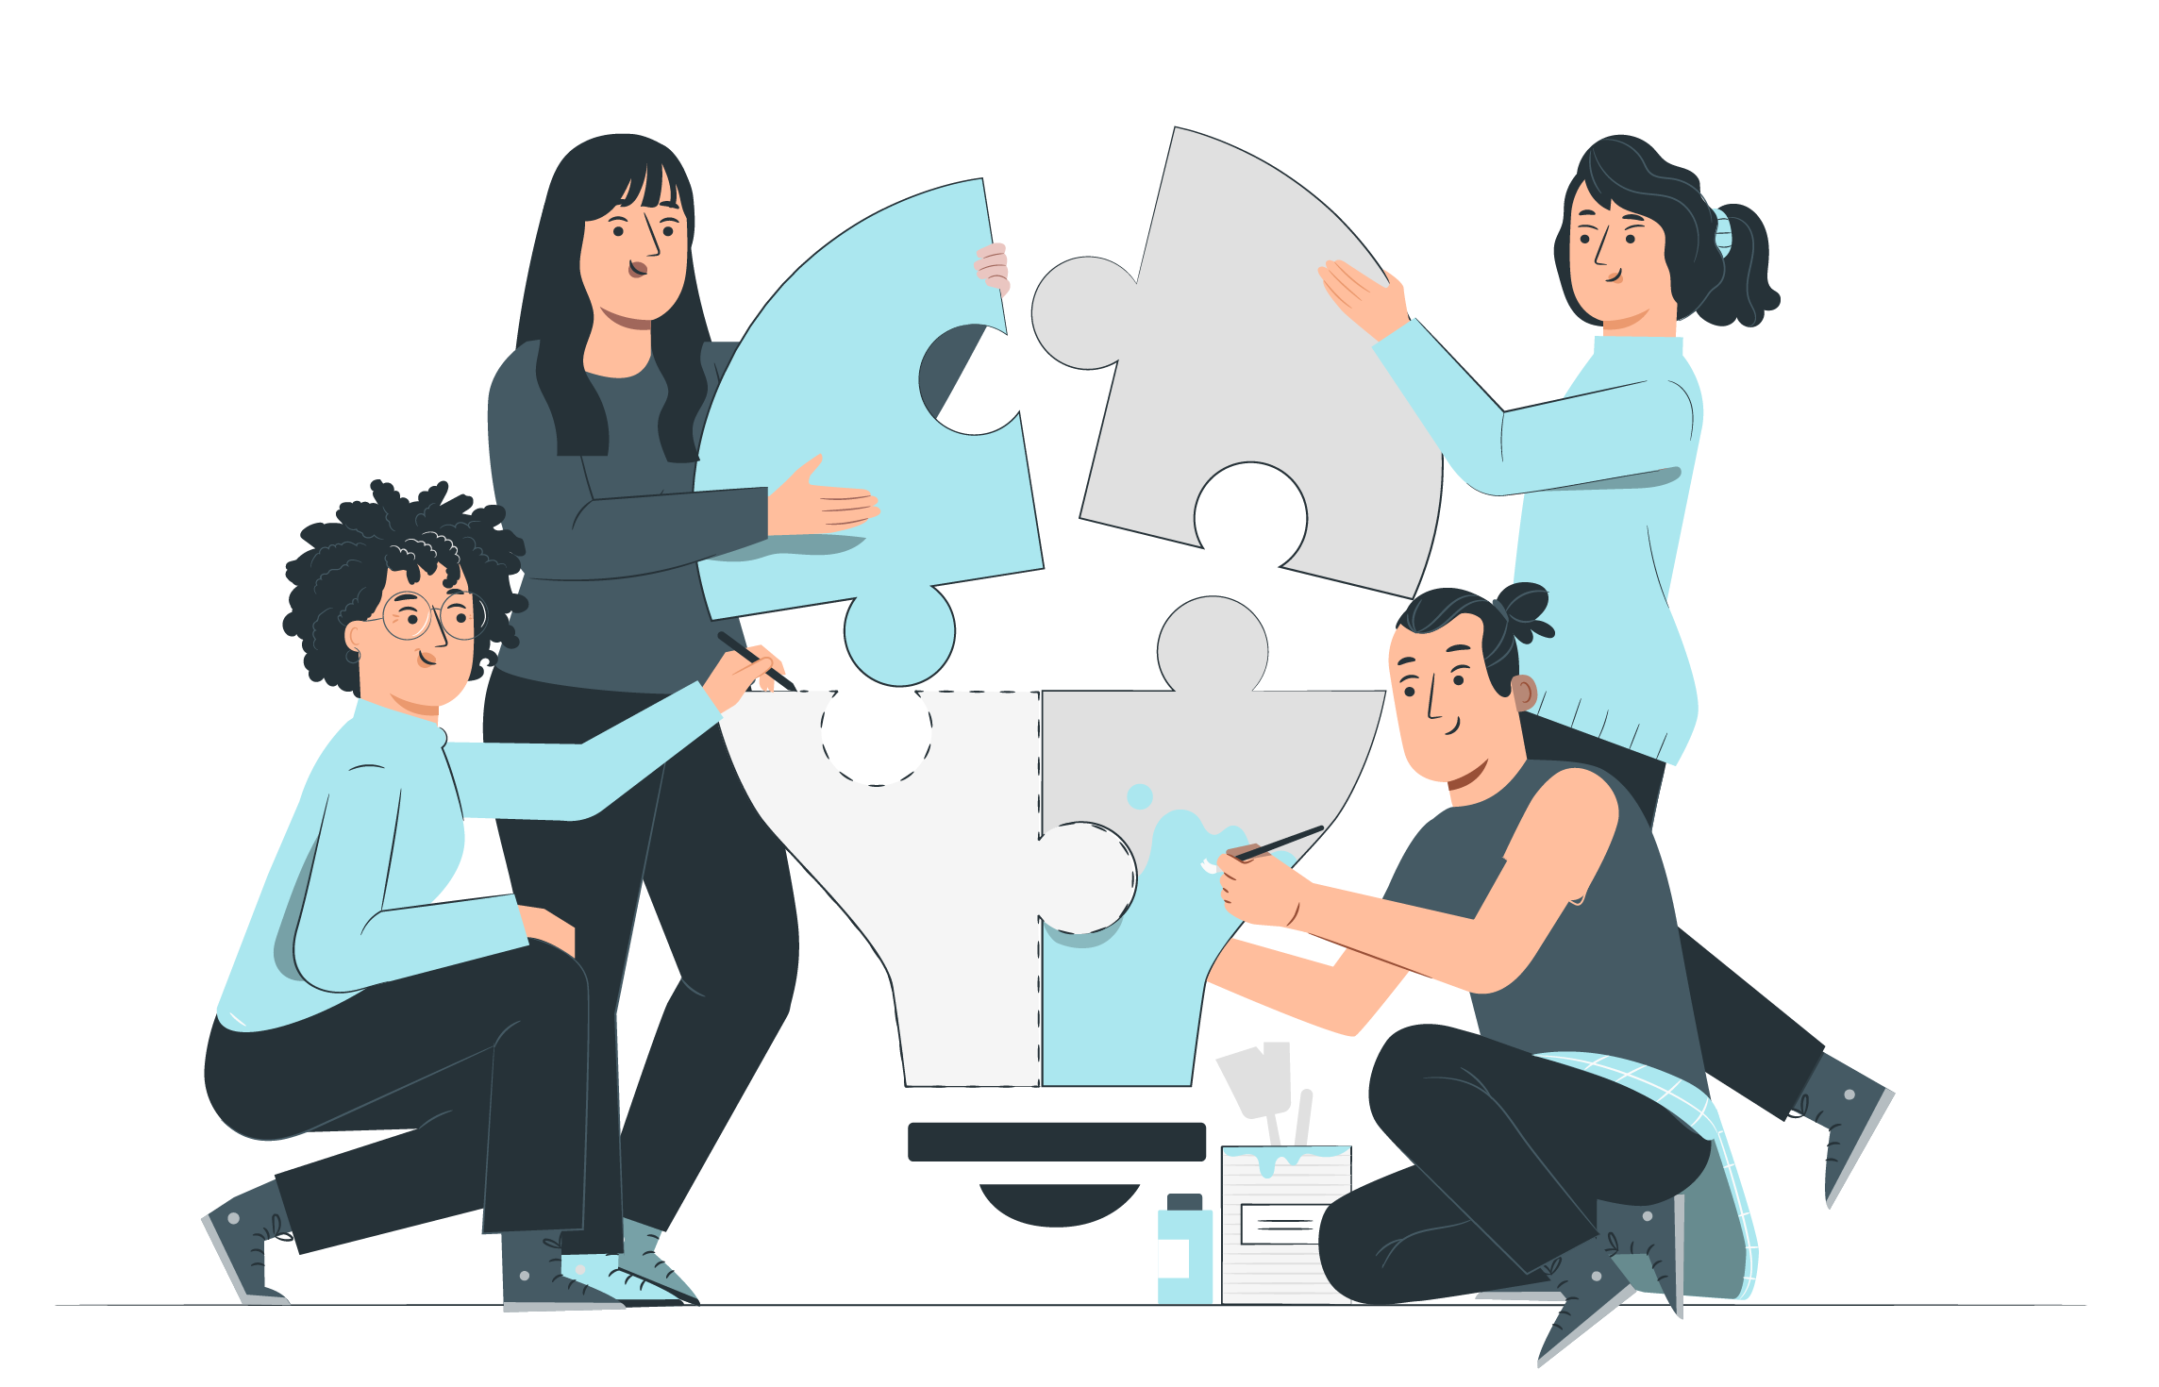
INTRODUCTION
Executive Summary
Issues when take part in a group for the first time
Group development stages
Background Information
The first meeting of a group of community volunteers includes:
Dave, Betty, Ray, Bill and Aisha
Raising funds for building a neighborhood play-ground.
Method: offline
Getting to know each other and discussing about project.

Slide 4
INTRODUCTION
Goals
Start building the connection among members.
Increase motivation, engagement, and satisfaction.
Ensure goals and expectations.
Keyword
working in group
first meeting
acquaintance
proposing ideas
giving opinions

Slide 5





ANALYZATION
Key issues and Problems
First meeting → Tension → Expression problems
(Primary tensions)
Struggle in planning a perfect project → Not well-prepared
Not enough quality time to plan, just raise ideas → Spontaneity
(Dialectic tensions)
The role of leadership isn't clear... → Bad leader → One of main problems.

Slide 6



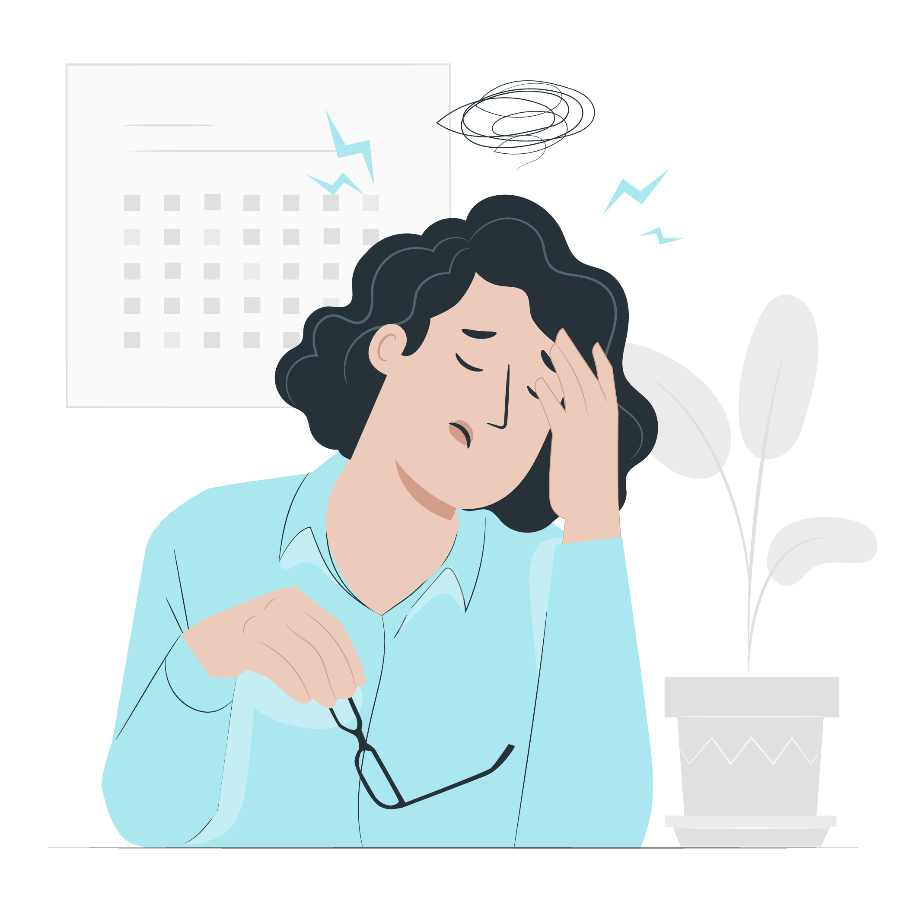
ANALYZATION
Case Evaluation
Good
Bad
By time, members in the group are working more smoothly (effectively), and expressing their opinions in comfy ways.
The connection is gradually formed.
They have already recognized their roles in this project.
→ Commitment
Not making constructive criticism.
Rejection of suggestions, opinions without appropriate arguments.
Not graceful and respectful.

Slide 7

ANALYZATION
Proposed Solutions
Be informal, more confident and outgoing.
Games or greeting activities.
Consider bonding activities as important part.
Good co-working space.
Small and short talk.
“Best behavior?”
→ Solution to primary tensions

Slide 8
ANALYZATION
Proposed Solutions
Leader
Avoid being domineering.
Rules for raising voice and expressing opinions.
Concentrate on common goal.
Every member
Give constructive, and evidence-based opinions.
Keep individual feelings in check and respect others.
Be fair, no prejudice.
The tension will decrease with time, be patient, collaborative.
Acknowledge and confront difficulties honestly.
→ Solution to dialectical tensions

Slide 9







SUMMATION
Conclusions
Understand the significance of working
in a group
Try our best to solve difficulties can lead us to a better goal
Fancy the chance to learn more social skills

Slide 10
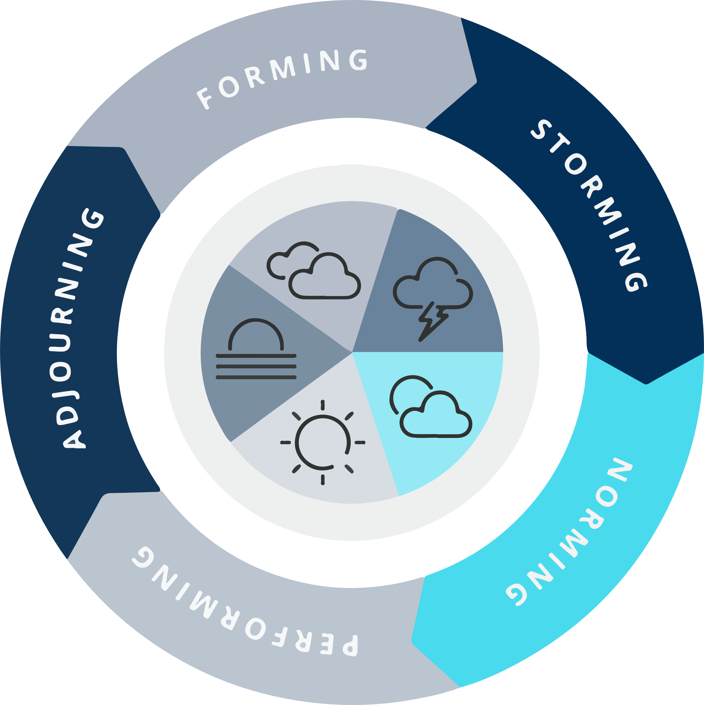
SUMMATION
Recommendations

Slide 11
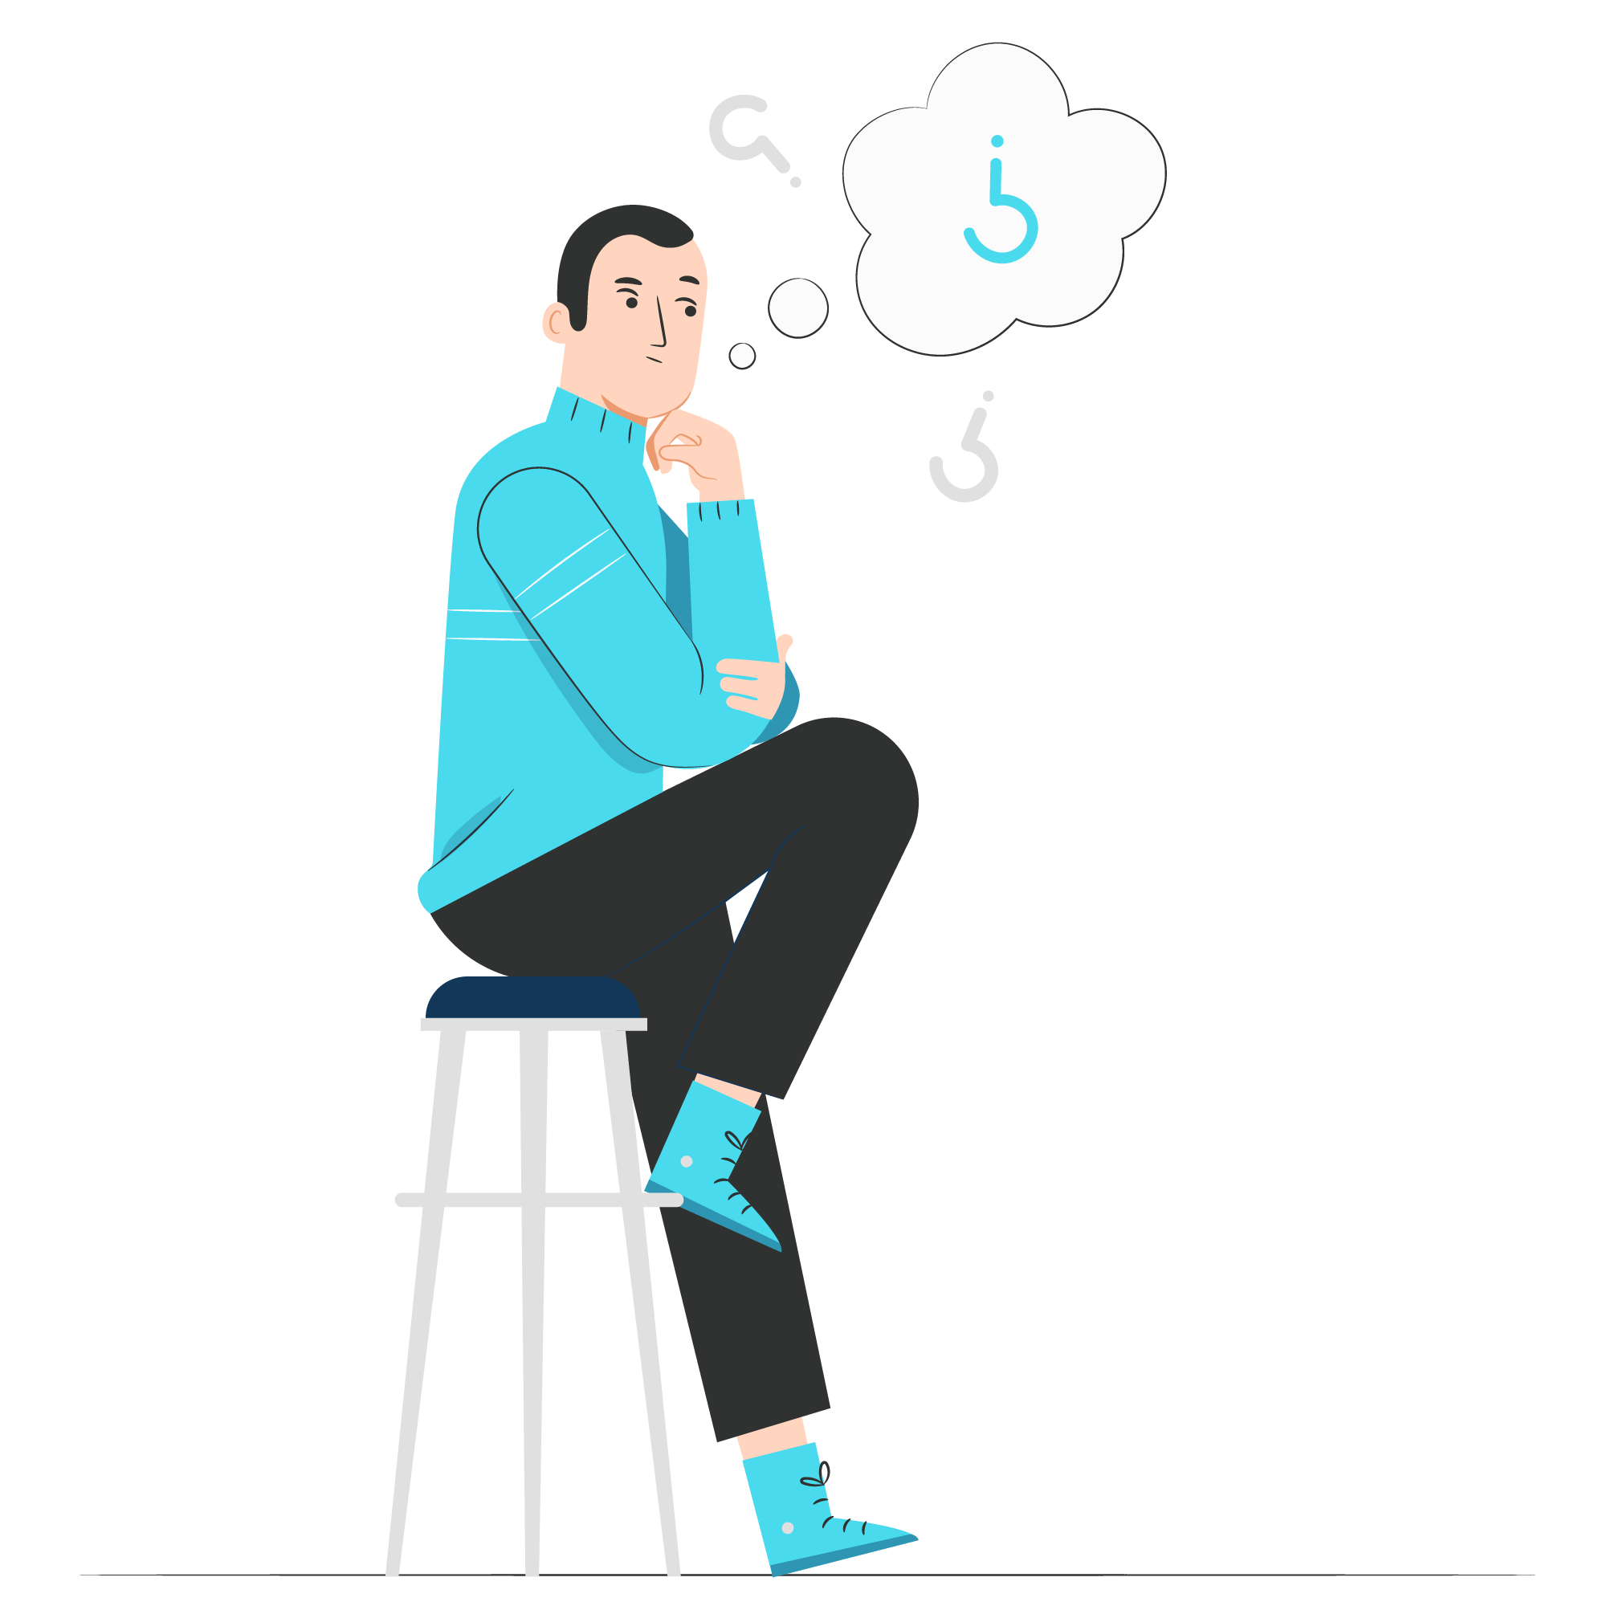
REFLECTION
1. What verbal and nonverbal behaviors demonstrated the forming stage of group development?
Verbal: Tone, Word
Nonverbal: Body movement, gestures
2. In your opinion, which members are most likely to compete for status and influence in the storming stage?
It’s Ray.

Slide 12
REFLECTION
3. What strategies did group members use or should they have used to decrease primary tension?
They did: Handshake, Smile
They should: Be Confident, Be Informal, Talk about themselves
4. What, if any, dialectic tensions will affect how well this group achieves its common goal and how well members get along with one another?
They do feel acquainted with each other after the meeting that lasts only a few minutes. There are some problems, such as Dave with dictatorial, or Bill, who is unable to talk about his bad feeling about Dave, and maybe the whole group when they ignore Betty, but these are not a huge problem if they move closer to It’s Raeach other.

Slide 13
CREDITS
Edited by: Dolphin Group – SSG103 / SE1602
Content contributors: Dang Loc, Phuoc Tung, Vi Khang, Thu Trang, Thanh Hai
Script writers: Dang Loc, Phuoc Tung, Vi Khang
Slides by: Dang Loc
Illustrations by: Freepik
Diagram by: Wikipedia

Slide 14
Q & A

Slide 15
Thank you!
Goodbye!
DolphinGroup

